Slide 1
Smartphone Analysis
Khofi Alfian

Slide 2
Problem
I want to buy a new smartphone but have little to no knowledge about gadget trend.
Objective
Using my skills in data analysis, I am trying to find the best smartphone to purchase in consideration of the smartphone specification and my budget.

Slide 3
Projek ini dibuat untuk membantu saya mengidentifikasi Smartphone yang cocok untuk dibeli dengan pertimbangan harga dan spesifikasi.

Slide 4
Data Scrapping
Data Preprocessing
Analysis & Modelling
Scrape Data
From website 1
Predictive machine learning model
Clean, Format and Combine the data
Scrape Data
From website 2
Power BI Dashboard
No
Buy Smartphone
Local machine database
Is it good
Scrape reviews
From website 1
Yes
Scrape reviews
From website 2
Clean, Format and Combine the data
Sentiment Analysis
Scrape reviews
From website 3

Slide 5
Data Scrapping
To be able to scrape data from a website we need to formulate step-by-step what we are going to do on the website. Also knowing the website architecture will be massive plus point.

Slide 6
Scrapping Smartphone Specification
Go to the website
Click link for each brand
Click product link for each brand
specification
Go to the website
Go to brand’s link
Go to brand’s product link
Scrape specification
Yes,
Go to next Page
Pagination

Slide 7
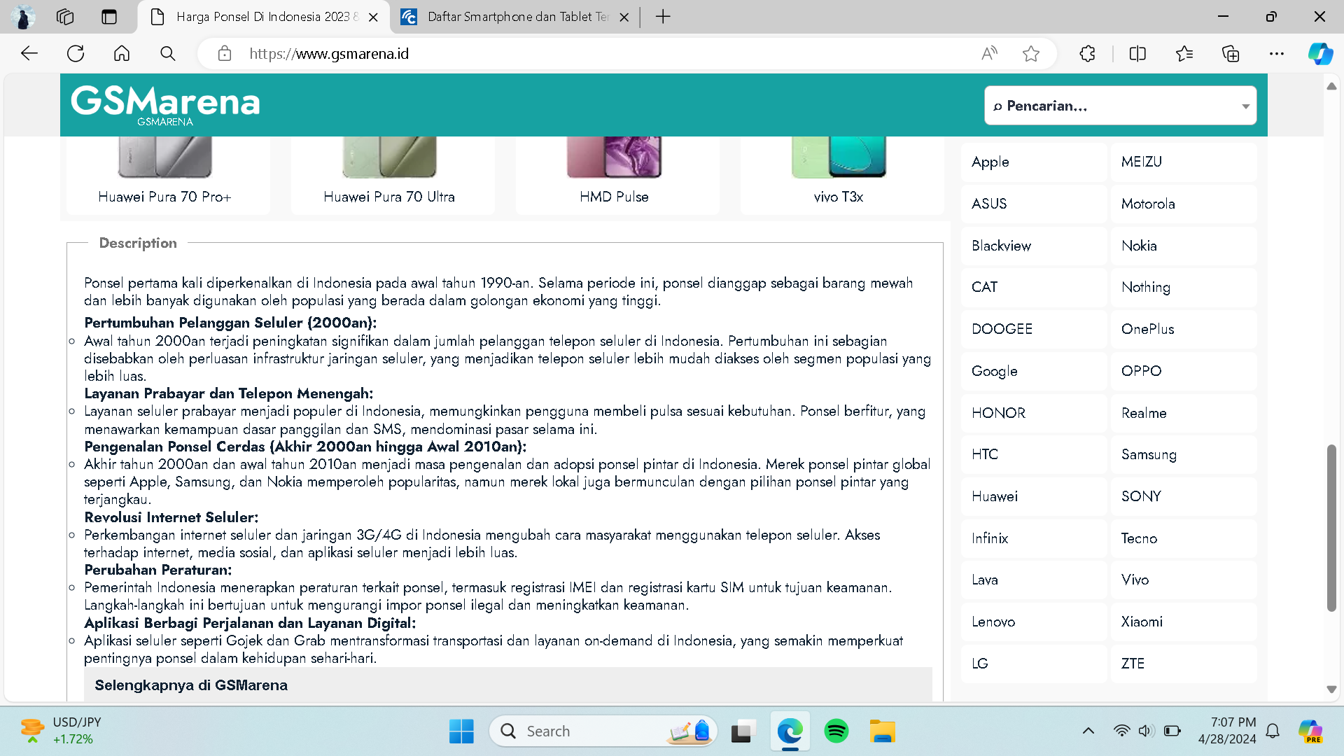
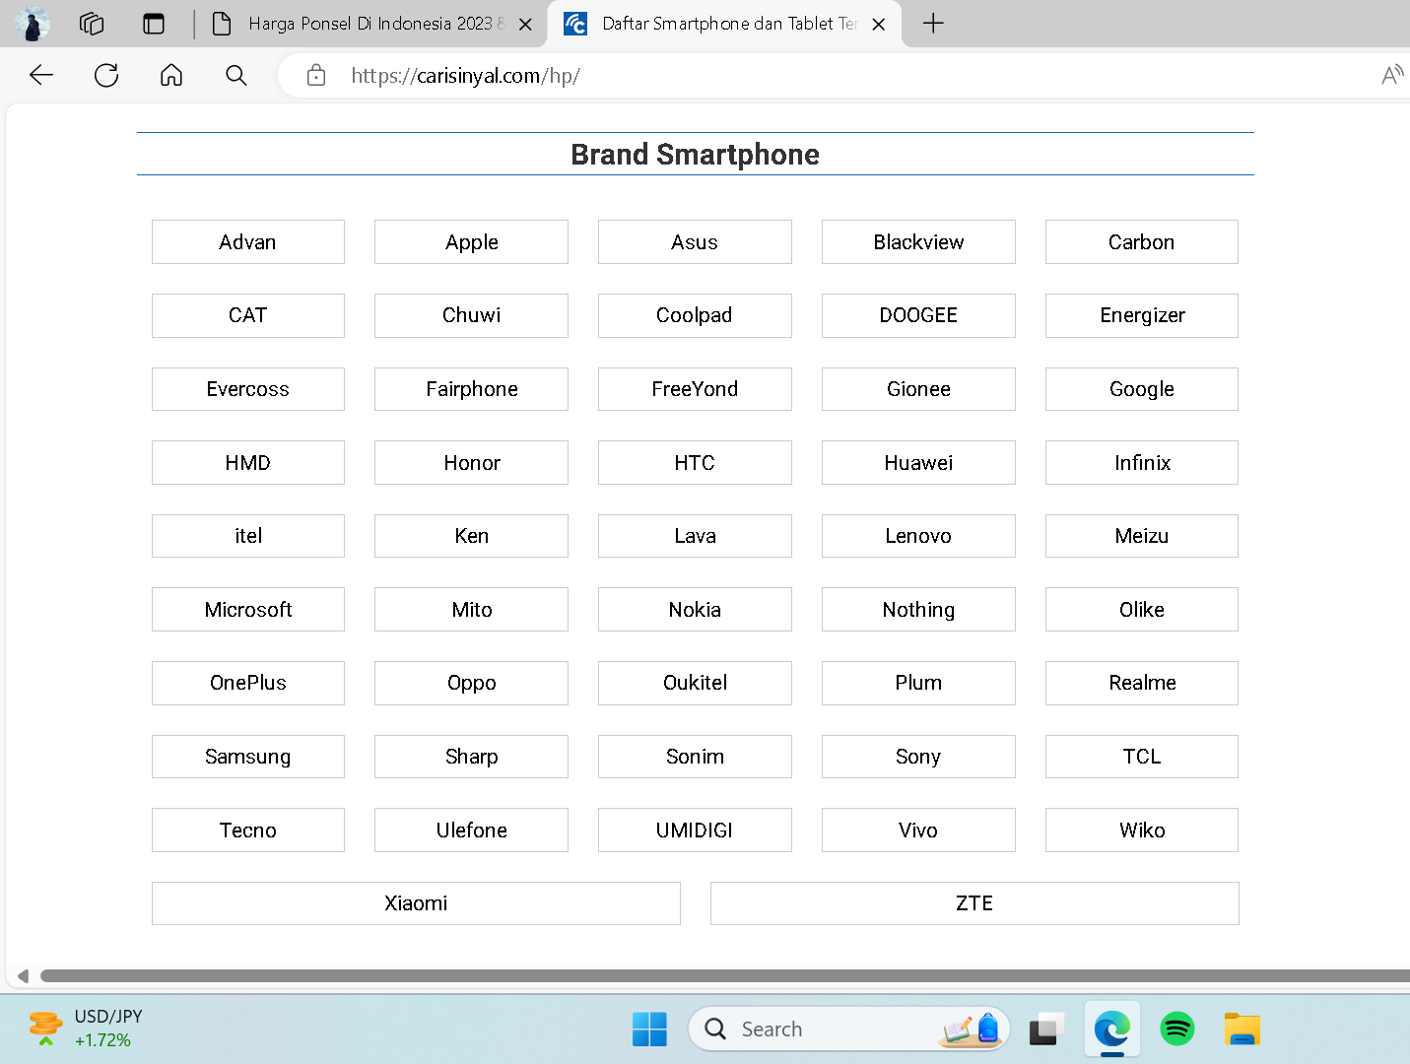
Scrapping Smartphone Specification
Website 1
Website 2

Slide 8
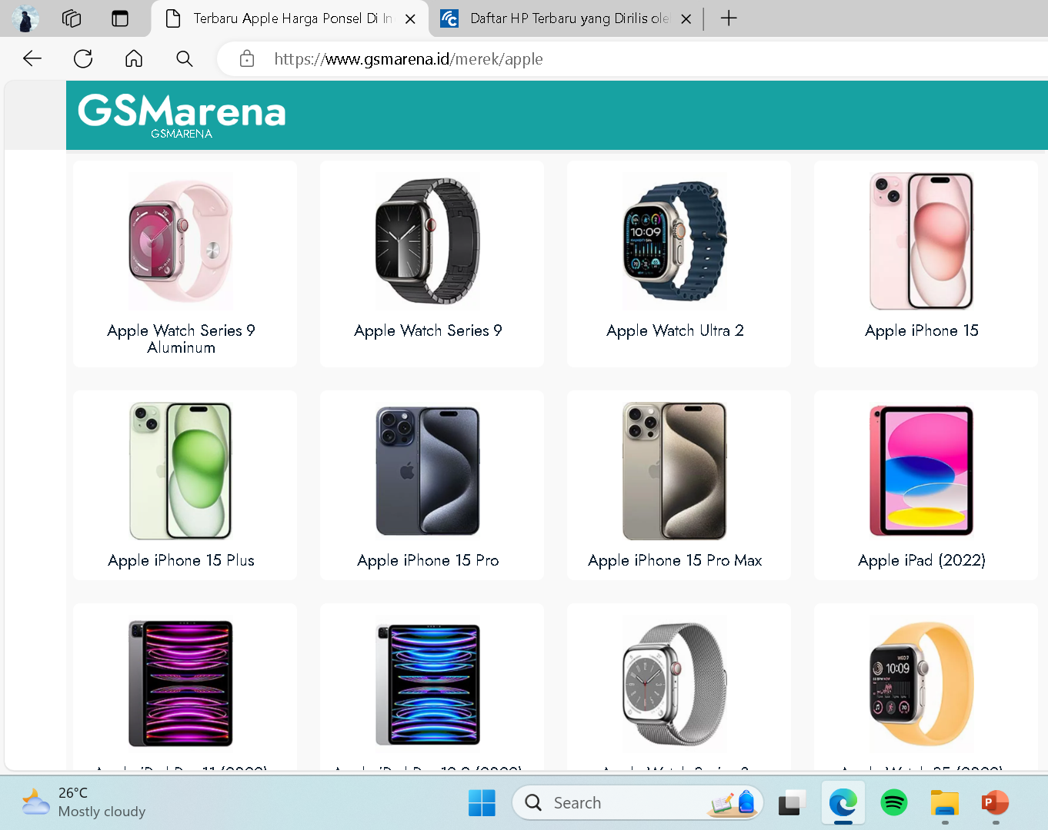
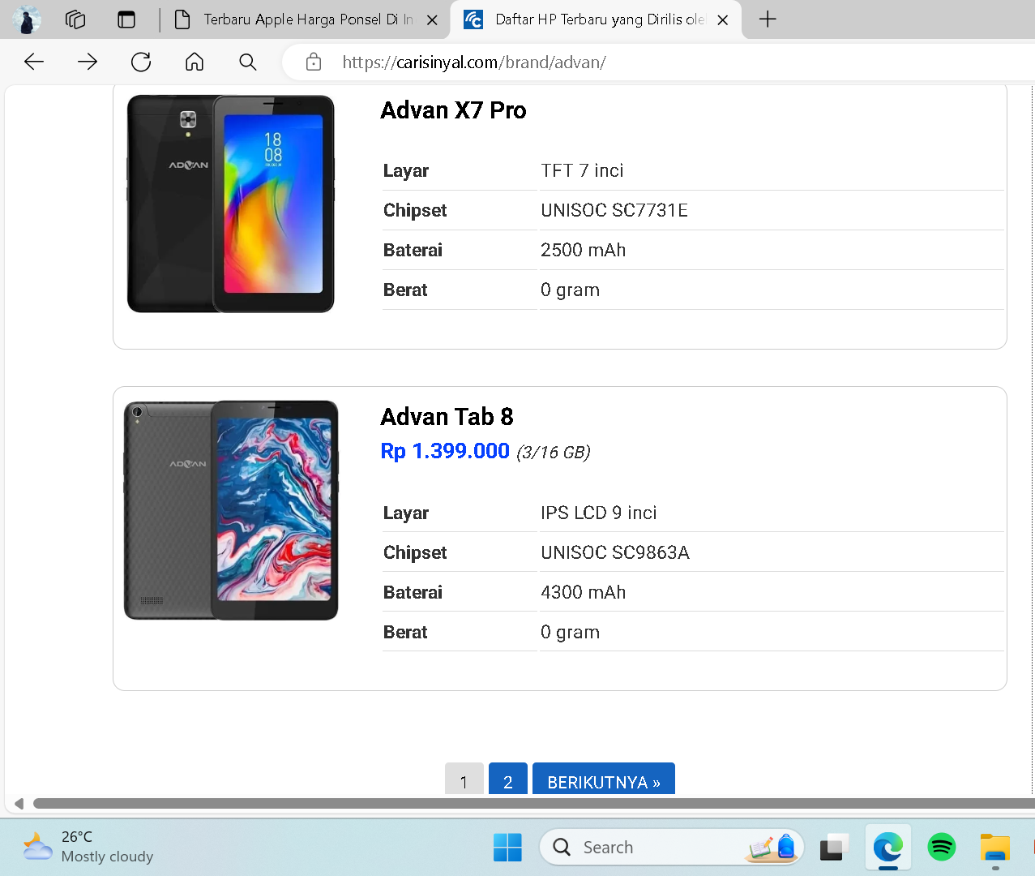
Scrapping Smartphone Specification
Website 1
Website 2

Slide 9
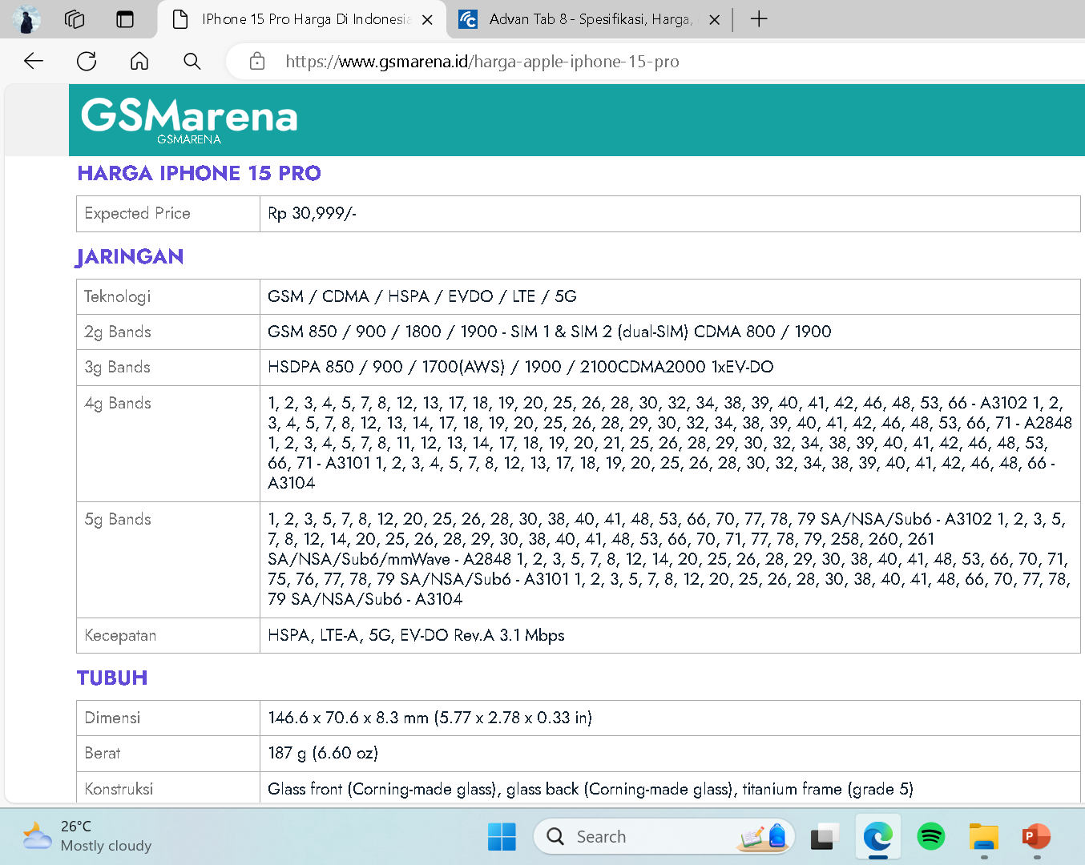
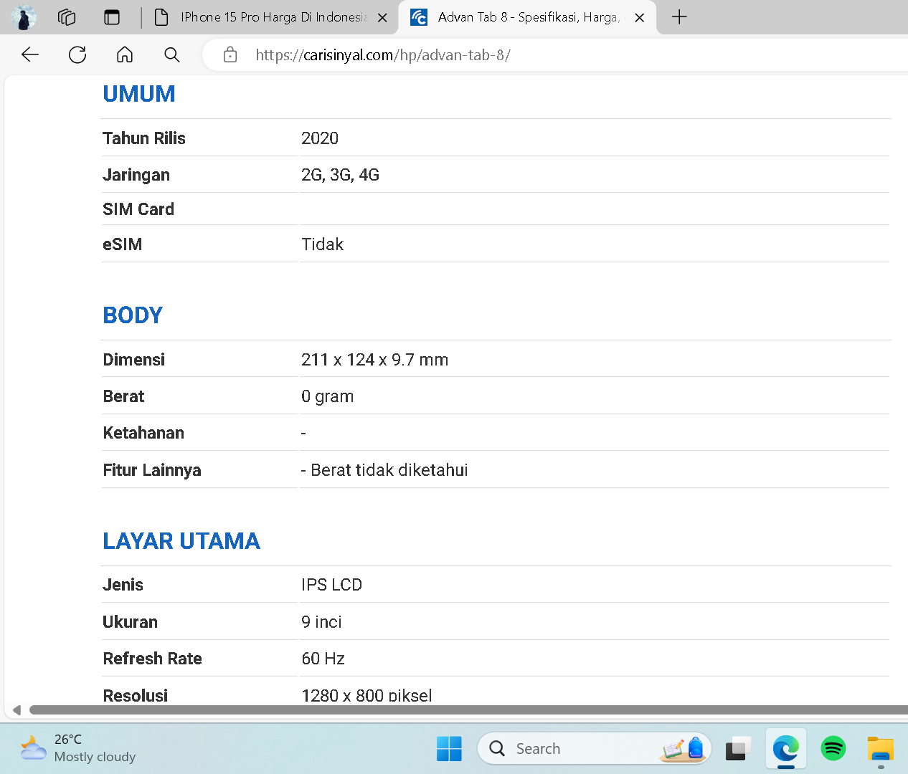
Scrapping Smartphone Specification
Website 1
Website 2

Slide 10
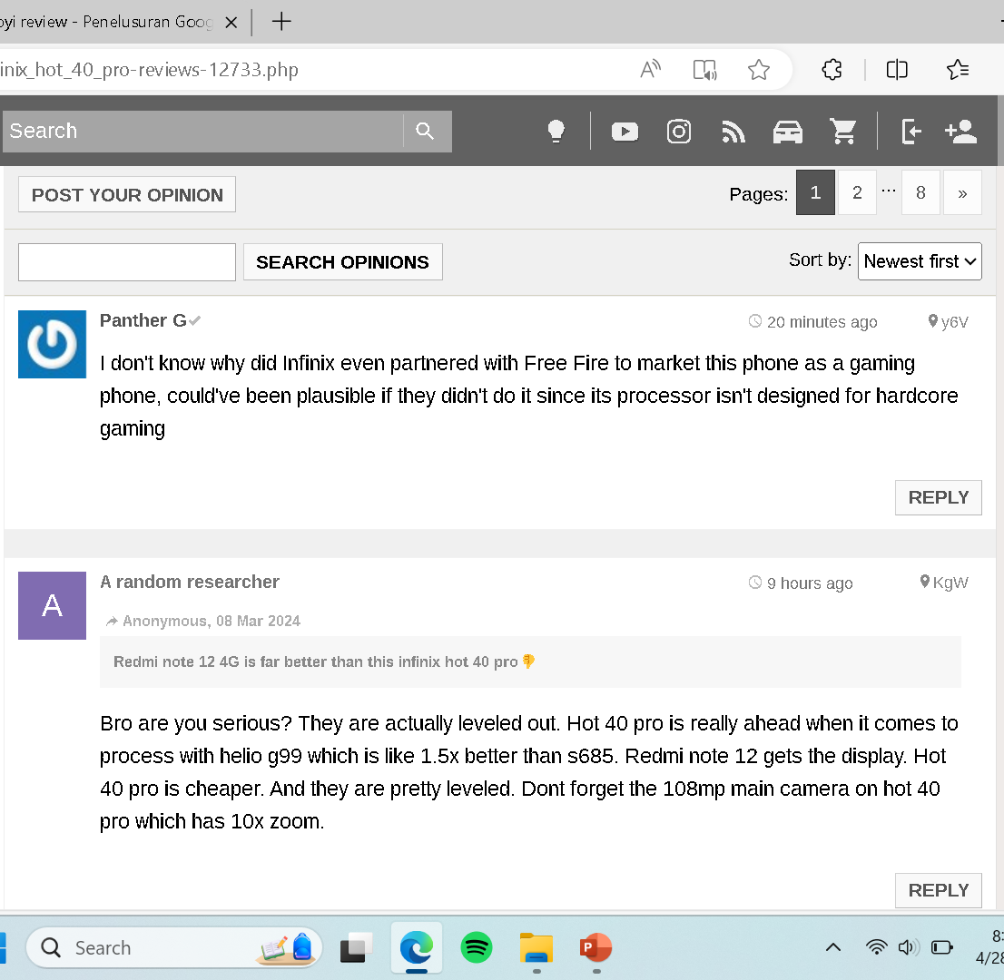
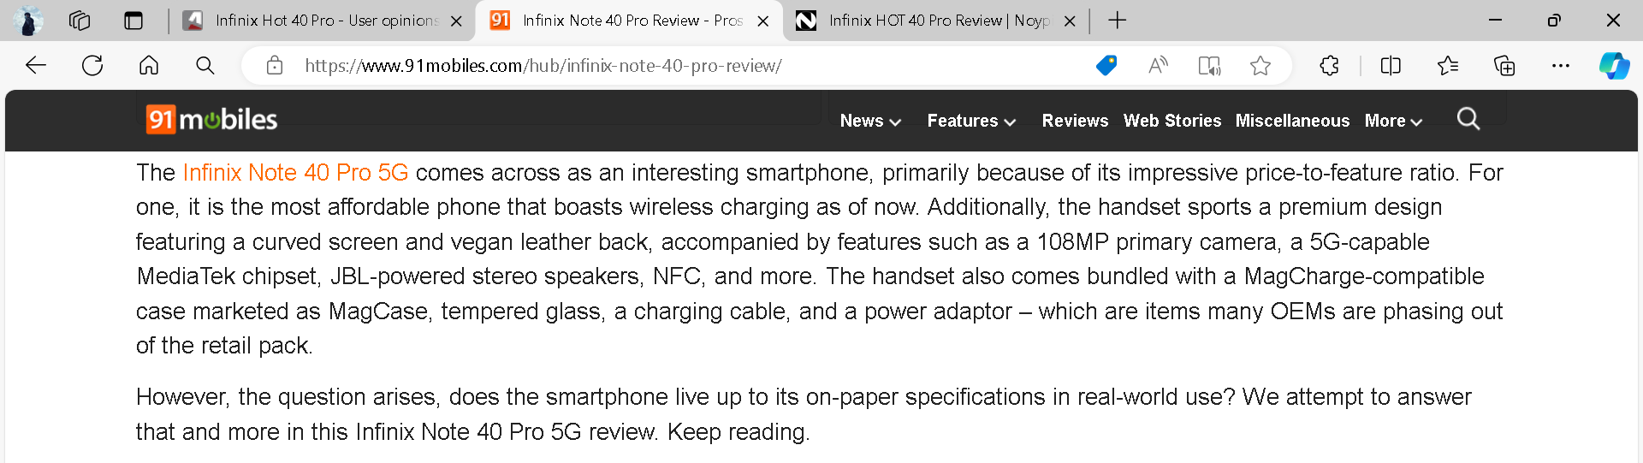
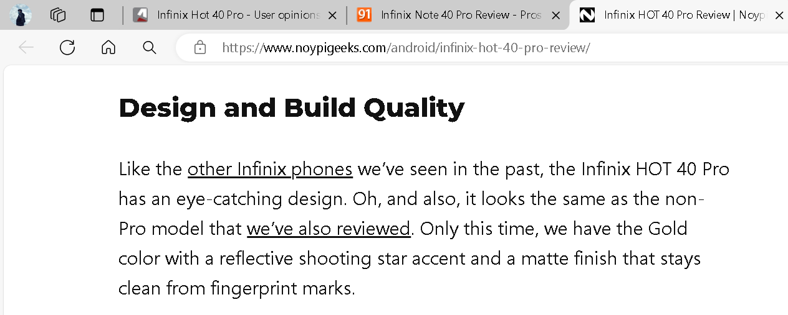
Scrapping Smartphone Reviews
Website 1
Website 2
Website 3

Slide 11
Data Scrapping
Check full code here:
https://github.com/Freezycoffee/smartphone/blob/main/scrape-smartphone-data.ipynb

Slide 12
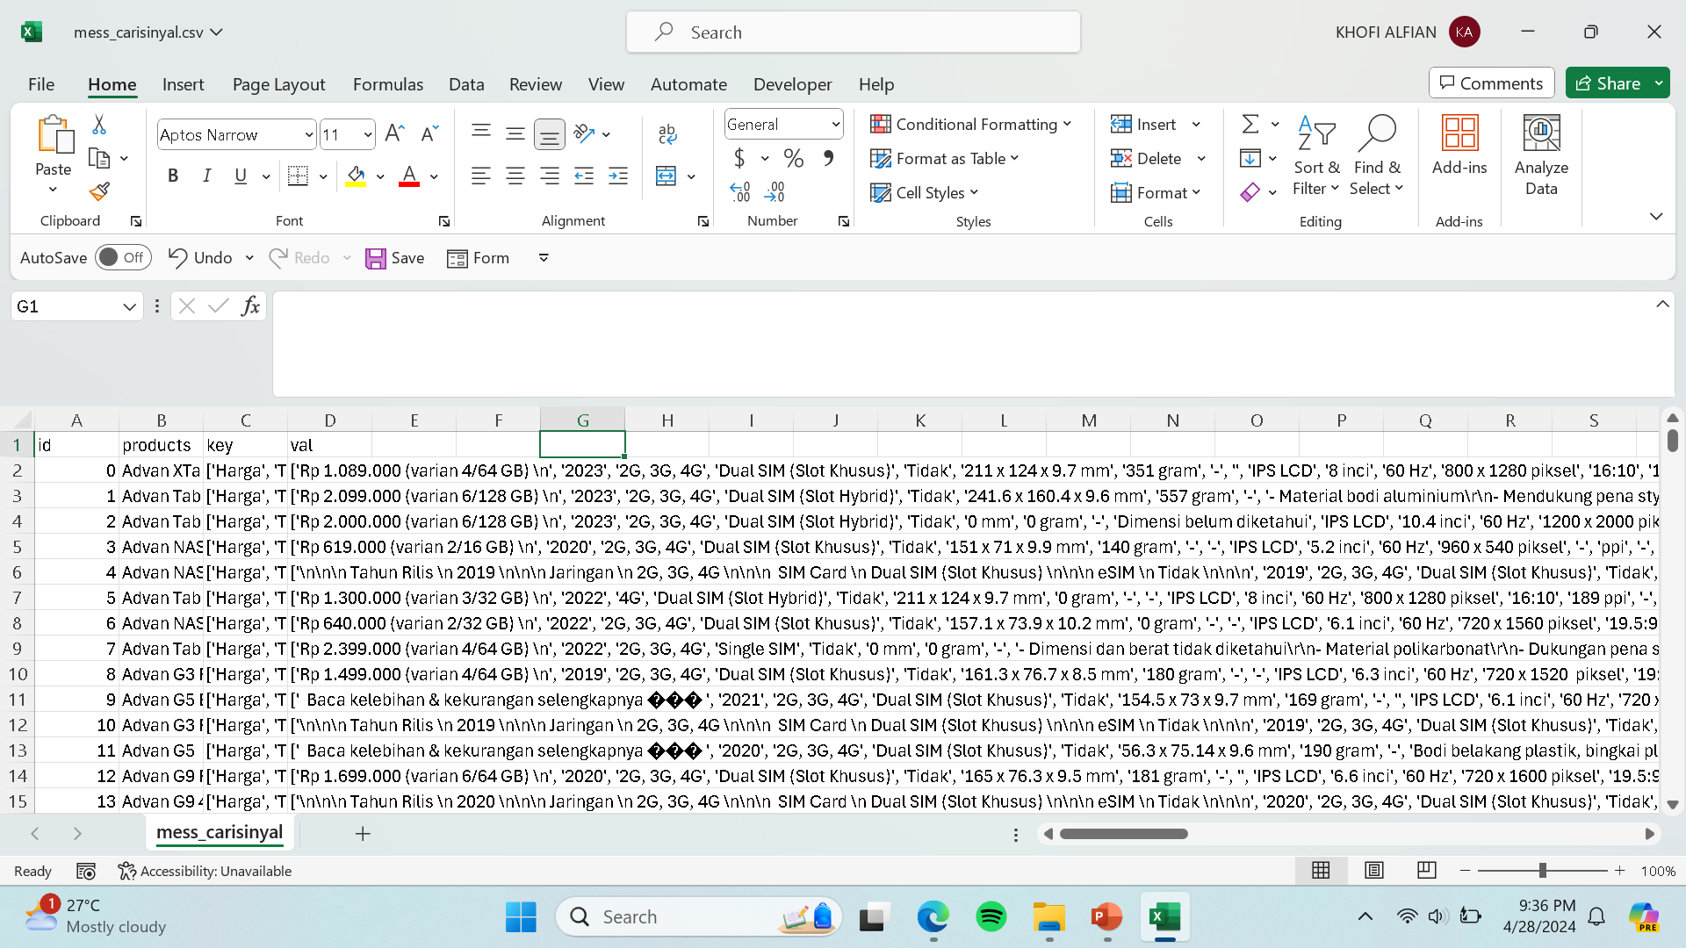
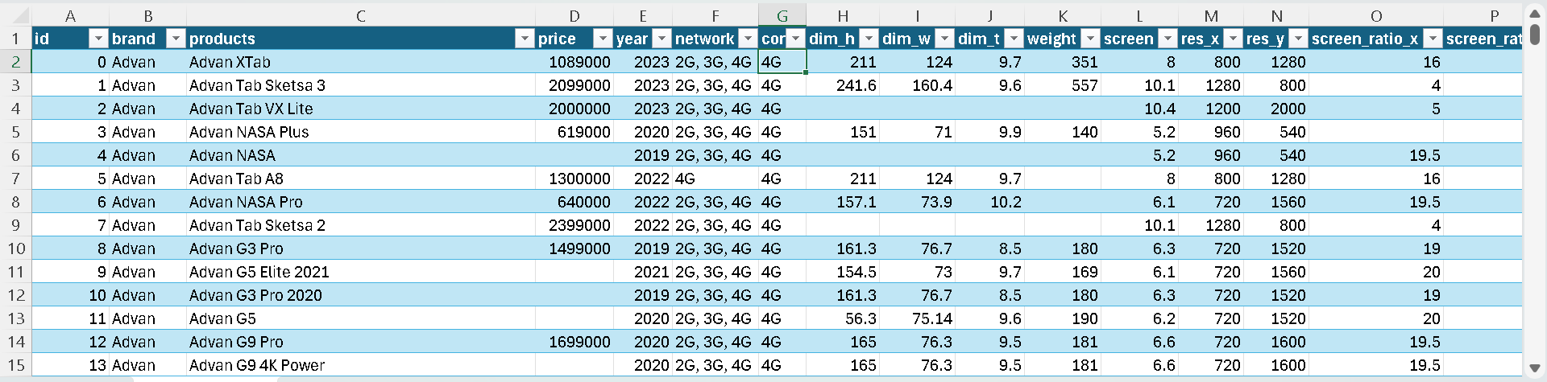
Data Preprocessing
Before
After

Slide 13
Data Preprocessing
Data Cleaning
For Data Cleaning, I am using Microsoft Excel to cleaning text, mixed data type, and formatting table to be more concise.
Handling Missing Values
As for handling missing values, I am using pandas and sklearn from python. First, I am using pandas to read the cleaned excel file. Then, using sklearn imputer to patch the missing values. For numeric columns I am using KNN Imputer to handle the missing values and for categorical or string columns I am using Simple Imputer with the most frequent as the strategy.
Check full code here:
https://github.com/Freezycoffee/smartphone/blob/main/smartphone.ipynb

Slide 14
Quick EDA
Let’s take look at the cleaned dataset that I already save it in my local machine database.
-- How many unique products are there in the dataset?
SELECT COUNT(DISTINCT products) FROM [dbo].[full_smartphone_data]
-- There are 2226 unique products in the dataset

Slide 15
-- How the prices vary for each brand?
SELECT
brand,
MIN(price) AS minimum_price,
MAX(price) AS maximum_price
FROM
[dbo].[full_smartphone_data]
GROUP BY
brand
-- How is the number of products varying across years?
SELECT
year,
COUNT(DISTINCT products) AS count_product
FROM
[dbo].[full_smartphone_data]
GROUP BY
year
ORDER BY
year

Slide 16
-- What is the most expensive product for each brand
WITH cte AS (
SELECT
brand,
products,
price,
ROW_NUMBER() OVER(
PARTITION BY brand
ORDER BY price DESC
) AS rank_price
FROM
[dbo].[full_smartphone_data])
SELECT
brand,
products,
price
FROM
cte
WHERE
rank_price = 1

Slide 17
-- What are the standout features from the expensive products?
WITH cte AS (
SELECT
brand,products,price,
ROW_NUMBER() OVER(
PARTITION BY brand
ORDER BY price DESC
) AS rank_price
FROM
[dbo].[full_smartphone_data])
SELECT
brand,products,
connection,screen,
pixel_density,chipset,
cpu,gpu,RAM,
storage,maincam,
frontcam,nfc,
battery_capacity,os,price
FROM
[dbo].[full_smartphone_data]
WHERE
products IN (
SELECT
products
FROM
cte
WHERE
rank_price = 1)
ORDER BY
price DESC
Most of the expensive products have standout features in common:
It is fold or flip type smartphone in some cases they are luxury smartwatch type.
Have good chipset, Qualcomm Snapdragon 8 equivalent or higher.
Have good GPU.
Bigger RAM.
Bigger Storage.

Slide 19

Power BI Dashboard

Slide 20
Power BI Dashboard

Slide 21
Power BI Dashboard

Slide 22
Predictive Machine Learning Model
Check here for the full dashboard:
https://app.powerbi.com/view?r=eyJrIjoiMGZlYzRiYWYtY2U0OC00ZWJiLWJjZWYtMWFmMGJjMTZmMzUzIiwidCI6IjUwODkxNmEwLTdiODktNDNhMS1hZjRlLTcyZmUxNWFiYTViOSIsImMiOjEwfQ%3D%3D
For creating predictive model, I am using XGBoost Regressor. Using features like brand, screen size, pixel density, RAM, CPU, GPU, storage, main camera, front camera etc. to predict the price of smartphone.

Slide 23
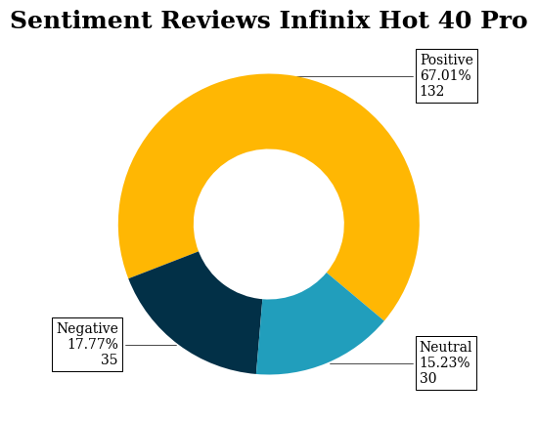
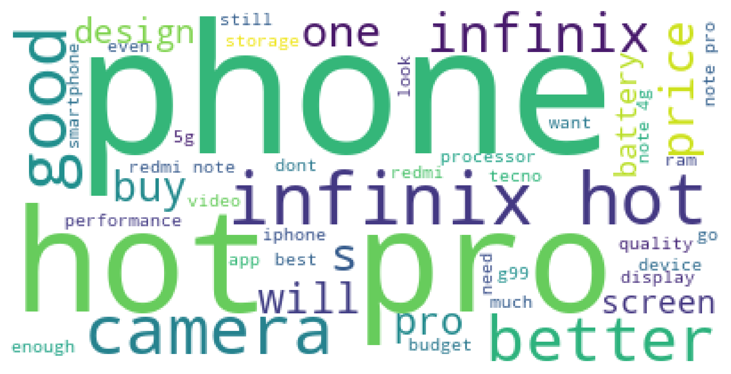
Sentiment Analysis
Sentiment analysis on Infinix Hot 40 Pro. I did analysis on reviews for Infinix product Infinix Hot 40 Pro using Natural Language Tool Kit (NLTK) package in Python. The way this package works is convert sentences into bag of words model and perform polarity test for each word using VADER Sentiment Analyzer.

Slide 24
Thank You
Please, Check on my GitHub Repository for more technical details:
https://github.com/Freezycoffee/smartphone

